Slide 1
Introduction to Software testing
Prepared by Chala Urgessa

Slide 2
Outline
Software testing in SDLC
Importance of Testing in Software Development
Basics of Software Testing
Types of software testing

Slide 3
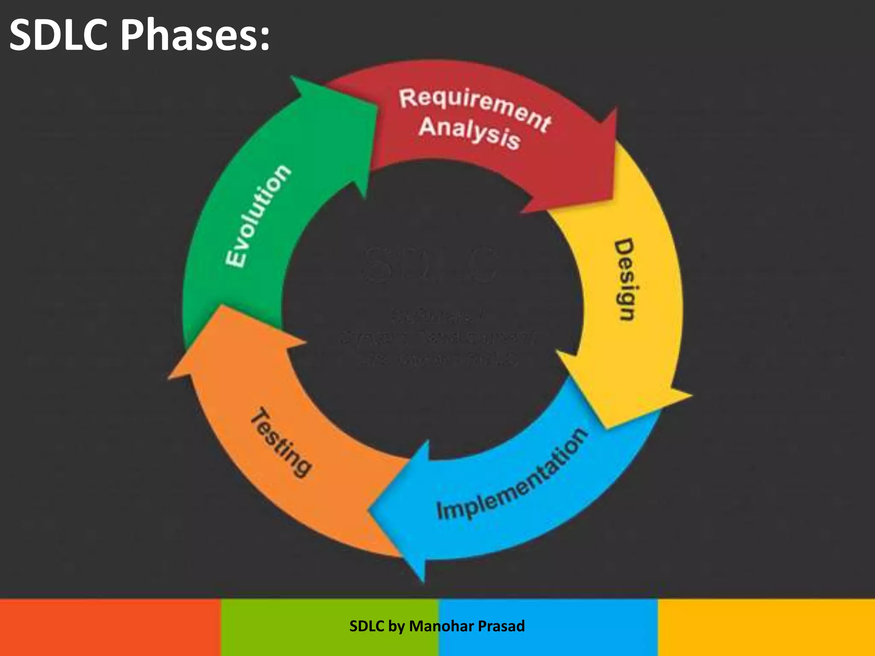
Software Development Life Cycle (SDLC) (软件开发生命周期 (SDLC))
A plan that shows the steps to make and maintain software. (是什么：展示创建和维护软件步骤的计划。)
Purpose: To make sure software is high quality, finished on time, and within budget. (目的：确保软件质量高，按时完成，且在预算内。)
Stages of SDLC (SDLC的阶段):
Planning (规划): Decide what to build and how.
Analysis (分析): Understand requirements and what the software should do.
Design (设计): Plan the software's look and how it will work.
Implementation (实施): Write the code for the software.
Testing (测试): Check the software for bugs and make sure it works as expected.
Deployment (部署): Put the software where users can access it.
Maintenance (维护): Update and fix the software over time.

Slide 4
The Role of Testing in SDLC (测试在SDLC中的角色)
Integration: Testing is part of every stage in modern SDLC models. (整合：在现代SDLC模型的每个阶段，测试都是一个组成部分。)
Focus: Specifically, this stage deals with finding and fixing bugs. (焦点：特别是，这个阶段处理发现和修复错误。)
Process (过程):
Defect Reporting: Finding bugs during testing. (缺陷报告：在测试期间发现错误。)
Tracking: Keeping record of the bugs found. (跟踪：记录发现的错误。)
Fixing: Developers work on correcting the reported issues. (修复：开发者着手纠正报告的问题。)
Retesting: Checking that fixes solve the problems without introducing new ones. (重新测试：检查修复是否解决了问题而没有引入新问题。)

Slide 5

Software Testing………….?
SoftwareTesting answers the question
“Does the s/w behave as specified…?”
“(关键问题："软件的行为是否符合规格说明？”
Software Testing is all about checking if software does what it's supposed to do. (定义：软件测试主要是检查软件是否按预期工作。)
Functionality: Makes sure the software works correctly. (功能性：确保软件正确工作。)
Performance: Confirms the software can handle the expected load. (性能：确认软件能够处理预期的负载。)
Integration: Verifies that the software works well with other systems. (集成：验证软件与其他系统良好协作。)

Slide 6
Testing………….? 测试定义
By Glen Myers: Testing is when you run a program to find errors. (Glen Myers的定义：测试是执行程序以找到错误的过程。)
Broad View: It's the process of finding any possible issue, big or small, in a software product. (广义观点：它是在软件产品中发现任何可能的问题，无论大小，的过程。)
ANSI/IEEE 1059 Standard: Testing analyzes software to spot differences between what it does and what it's supposed to do, identifying defects, errors, or bugs, and assessing the software's features. (ANSI/IEEE 1059标准：测试是分析软件以便发现实际情况与预期之间的差异（即缺陷、错误、漏洞）并评估软件特性的过程。)
Goals of Testing (测试的目标)
Correctness: Ensure the software does exactly what it was designed to do. (正确性：确保软件准确执行其设计的功能。)
Completeness: Verify that all features and functionalities are present and working. (完整性：验证所有功能和特性都存在且工作正常。)
Quality: Measure how well the software performs its intended functions. (质量：衡量软件执行既定功能的效果如何。)

Slide 7
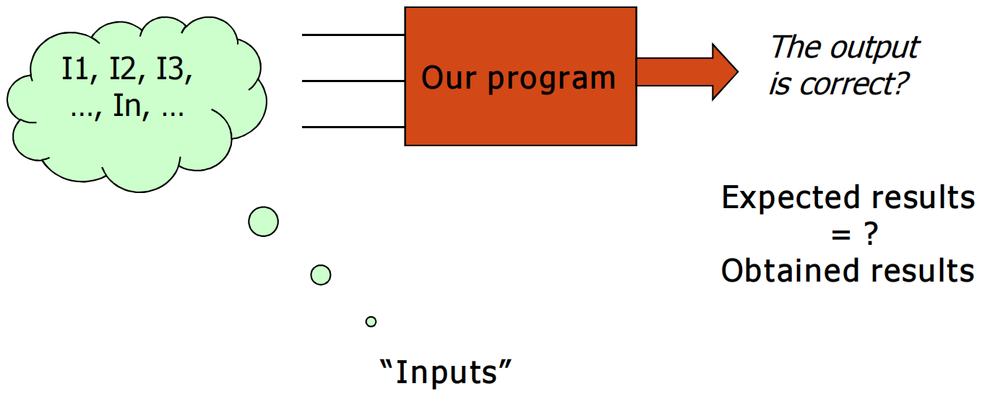
Testing in Practice (实践中的测试)
Testing a program with different inputs helps find mistakes, known as errors or failures. (它做什么：通过对程序使用不同的输入来帮助发现错误或失败。)
How It Works: By giving the program various inputs, we can see how it behaves and identify when it doesn't work as expected. (如何工作：通过给程序提供各种输入，我们可以观察它的行为并识别它何时未按预期工作。)

Slide 8
Limits of Testing (测试的限制)
Detecting Errors: Testing is good at finding out if there are problems. (检测错误：测试擅长于发现问题。)
Proving Correctness: However, to say for sure there are no errors at all (proving the program is 100% correct) would require testing every possible input, which is usually not practical. (证明正确性：然而，要确定完全没有错误（证明程序100%正确）需要测试所有可能的输入，这通常是不切实际的。)
Key Takeaway (关键点)
Testing reveals errors: It's a critical tool for improving software quality by identifying failures. (测试揭示错误：它是通过识别失败来提高软件质量的关键工具。)
Exhaustive testing is impractical: While testing can find many errors, it cannot guarantee to find every single one due to the vast number of possible inputs. (穷尽测试是不切实际的：虽然测试可以发现许多错误，但由于可能的输入数量庞大，它不能保证找到每一个错误。)

Slide 9
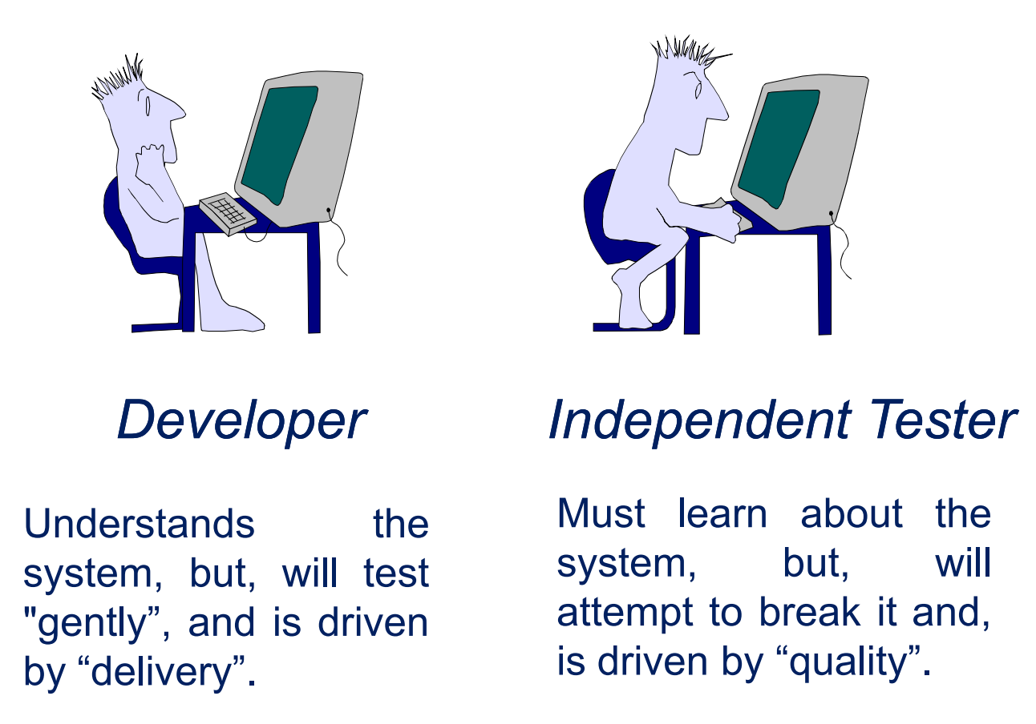
Who Tests the Software….?

Slide 10
Summary on Objectives of Testing (测试的目标)
1. Verify Requirements: Ensure that the software meets the specifications it was designed from. This includes checking:
The correctness of requirement specifications.
The software's response to these requirements through its design and coding.
2. Identify Bugs: Aim to find as many defects or bugs in the software as possible.
Important Insights (重要见解)
Testing Limits:
While testing is effective at detecting the presence of errors and bugs, it's important to understand its limitations.
Testing can reveal where and when the software fails, but it cannot prove that the software is completely free from errors.

Slide 11
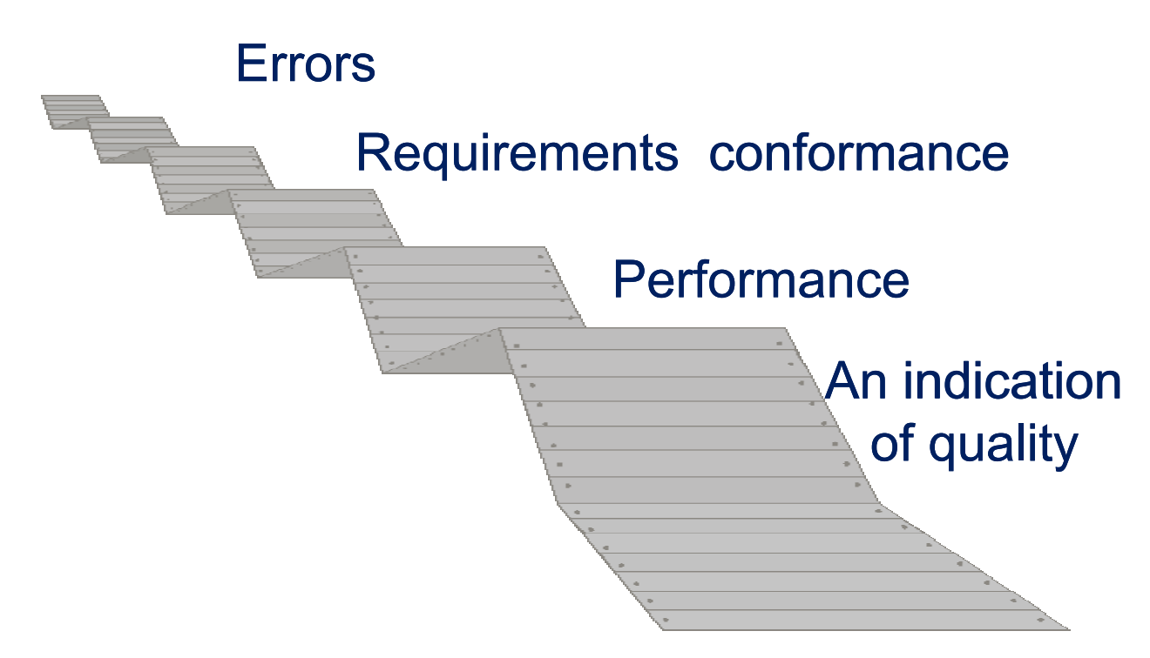
What Testing Shows…?

Slide 12
When to Start Testing? (何时开始测试？)
Early Testing Benefits (早期测试的好处)
Cost-Effective: Starting testing early can save money by reducing the amount of rework needed. (成本效益：早期开始测试可以通过减少需要的返工量来节省资金。)
Time-Saving: It helps in delivering the software faster by catching and fixing errors sooner. (节省时间：通过更早地捕捉和修复错误，帮助更快地交付软件。)
Quality: Leads to more reliable and error-free software for the client. (质量：为客户提供更可靠、无错误的软件。)
Testing in SDLC (在SDLC中测试)
Throughout SDLC: Testing should begin as early as the Requirements Gathering phase and continue until the software is deployed. (贯穿SDLC：测试应该从需求收集阶段开始，一直持续到软件部署。)However it also depends on the development model that is being used.

Slide 13
Influence of Development Model (开发模型的影响)
Waterfall Model: Testing occurs in a distinct phase after the development is complete. (瀑布模型：测试在开发完成后的一个独立阶段进行。)
Incremental Model: Testing is done at the end of each increment/iteration, with a final test of the whole application at the end. (增量模型：在每个增量/迭代的末尾进行测试，并在最后对整个应用程序进行最终测试。)

Slide 14
When to Stop Testing? (何时停止测试？)
Understanding the Challenge (理解挑战)
Unlike deciding when to start, knowing when to stop testing is more complex. It's hard to say a software is 100% error-free because testing is an ongoing process. (与决定何时开始不同，知道何时停止测试更加复杂。很难说软件是100%没有错误的，因为测试是一个持续的过程。)
Criteria for Stopping Testing (停止测试的标准)
1. Testing Deadlines (测试截止日期): When the project reaches its testing deadline. (当项目到达其测试截止日期。)
2. Management Decision (管理决策): Sometimes, the decision to stop testing is made by management. (有时，停止测试的决定由管理层做出。)
3. Completion of Test Case Execution (测试用例执行完成): All planned test cases have been run. (所有计划的测试用例已运行。)
4. Functional and Code Coverage (功能和代码覆盖): Testing has covered enough of the functionality and code. (测试已足够覆盖功能和代码。)
5. Bug Rate (错误率): The number of bugs is low and no high-priority issues remain. (错误的数量很低，且没有剩余的高优先级问题。)

Slide 15
Traditional Testing Approach (传统测试方法)
Developers and testers often work in separate camps (分开的阵营):
Developers aim to write working software (开发者的目标是编写可工作的软件),
while testers aim to find problems in the software (测试人员的目标是在软件中找到问题).

Slide 16
Test-Driven Development (TDD) Approach (测试驱动开发)
Shift in Testing Effort (测试工作的转变): TDD places the majority of testing efforts on developers (TDD将大部分测试工作放在了开发者身上).
Process (过程): Developers write tests before coding to ensure that all new features pass tests from the start (开发者在编码前编写测试，以确保所有新功能从一开始就通过测试).
Benefits (好处): Aims to create more reliable, bug-free software from the start and improves collaboration (旨在从一开始就创建更可靠、无错误的软件，并提高协作效率).
Adoption (采纳): Google and many other companies have embraced TDD (Google和许多其他公司已经采用了TDD).

Slide 17
Some Terminologies
Errors (错误)
An error is when a software developer makes a mistake, misconception, or misunderstanding. (定义：错误是软件开发者的误解、错误观念或误解。)
Faults / Defects / Bugs (故障 / 缺陷 / 错误)
A fault or defect is introduced into the software because of an error. These are the actual coding mistakes we often refer to as "bugs." (定义：由于错误而引入软件的故障或缺陷。这些实际的编码错误通常被称为“错误”。)
It's an anomaly that may cause the software to act incorrectly, not following its specification. (影响：它是软件中的异常，可能导致软件行为不正确，不符合其规范。)
Failures (失败)
A failure happens when the software system or component can't perform its required functions within the specified performance requirements. (定义：当软件系统或组件无法在指定的性能要求内执行其所需功能时，就会发生失败。)
Not all faults in code lead to failures. Faulty software can work for a long time without showing incorrect behavior. But under certain conditions, these faults will lead to failures. (注：并非所有代码中的故障都会导致失败。有缺陷的软件可以长时间工作而不显示不正确的行为。但在特定条件下，这些故障将导致失败。)

Slide 18
Fault - Failure - Error -- illustrations
Fault: The fault that causes the failure is in line 5. The * operator is used instead of +.
Error: The error that conduces to this fault may be:
a typing error (the developer has written * instead of +)
a conceptual error (e.g., the developer doesn't know how to double a number)
Failure: x = 3 means y = 9 →-> Failure!
• This is a failure of the system since the correct output would be 6
LOC Code
1 program double ();
2 var x,y: integer;
3 begin
4 read(x);
5 y = x * x;
6 write(y)
7 end

Slide 19
Defect Severity/Priority (缺陷严重性/优先级)
These are common definitions of defect severities or priorities (terms
severity and priority are often used interchangeably)
P1 – Showstopper (P1 – 阻碍者)
A critical issue that may cause a system crash or render a large part of the software's functionality unusable. (定义：一个严重问题，可能导致系统崩溃或使大部分软件功能不可用。)
P2 – Critical (P2 – 关键)
A serious problem that affects major functionality, like not being able to add an item to the shopping cart. (定义：一个严重问题，影响主要功能，例如无法将商品添加到购物车。)

Slide 20
Cont...
P3 – Major (P3 – 主要)
An issue that impacts the software's operation but doesn't cripple its core functionality, such as incorrect tax computation or issues updating item quantities in the shopping cart. (定义：影响软件操作的问题，但不会削弱其核心功能，如税款计算错误或更新购物车中商品数量的问题。)
P4 – Minor (P4 – 次要)
A less critical issue, often related to the software's appearance or user interface, such as poor alignment, spelling mistakes, or incorrect wording. (定义：一个不太严重的问题，通常与软件的外观或用户界面有关，如对齐不良、拼写错误或措辞不当。)

Slide 21
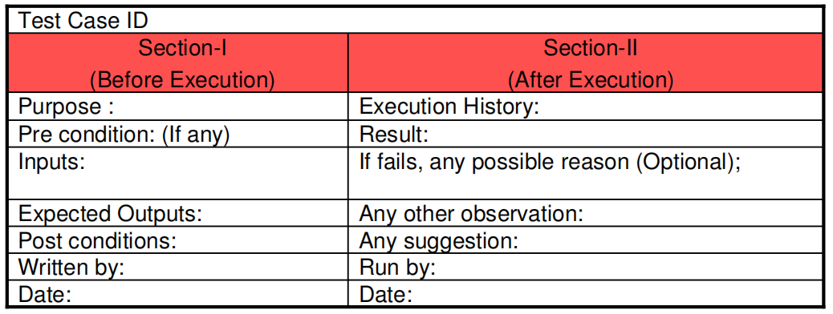
Test and Test Case (测试和测试用例)
Test/Test Case (测试/测试用例): Both terms describe the process of evaluating a piece of software by providing it with an input and comparing the actual output with the expected output. In practice, they're considered synonyms. (这两个术语都描述了通过向软件提供输入并将实际输出与预期输出进行比较来评估软件的过程。在实践中，它们被视为同义词。)
Test Set (测试集): A group of related tests or test cases is sometimes referred to as a test set. This grouping is usually based on the functionality being tested or other logical relationships. (定义：一组相关的测试或测试用例有时被称为测试集。这种分组通常基于被测试的功能或其他逻辑关系。)
Fig. 2: Test case template

Slide 22
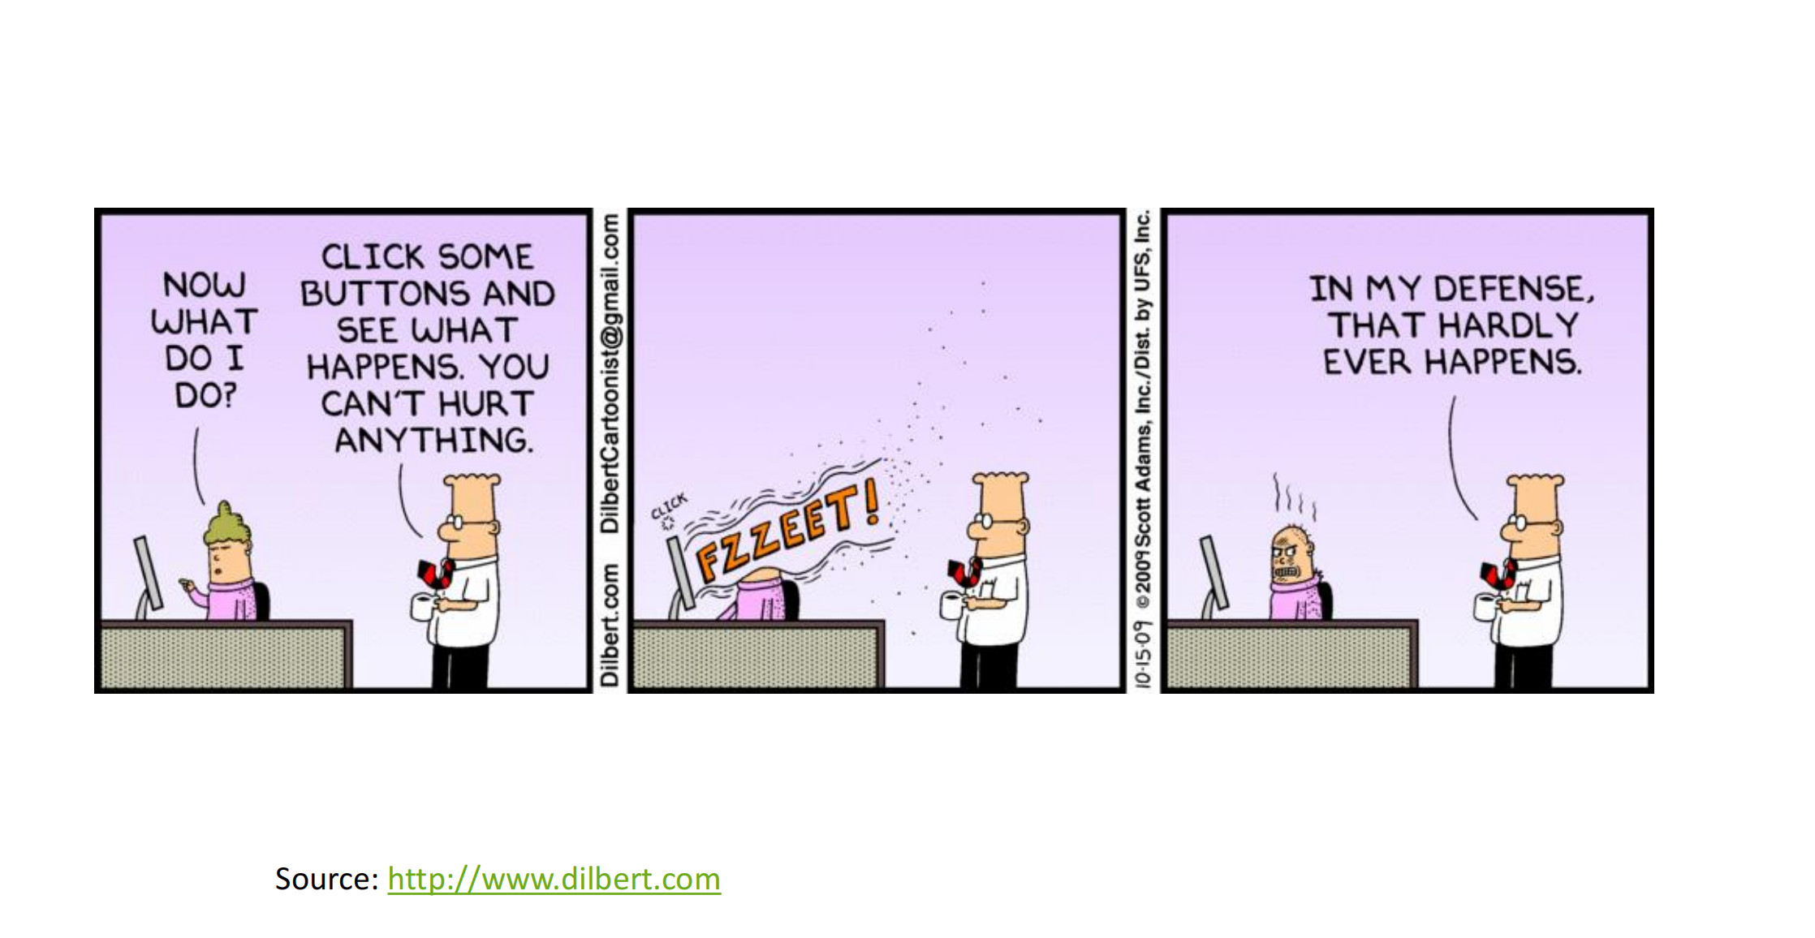

Slide 23
Cont...
Test Suite (测试套件):
A test suite is a collection of test cases that are designed to be executed together to test a specific functionality or a set of functionalities within the software. It's essentially a package of tests grouped for a particular testing purpose.
(定义：测试套件是一组设计在一起执行的测试用例，用于测试软件中的特定功能或一组功能。它本质上是为特定测试目的而分组的测试包。)
Any combination of test cases may generate a test suite, meaning it can be tailored to focus on different aspects of the software depending on the testing needs. (组成：任何测试用例的组合都可以生成测试套件，这意味着它可以根据测试需求针对软件的不同方面进行定制。)
Test suites are particularly useful for regression testing, where tests are frequently rerun to ensure new changes haven't broken existing functionality. They're also used to group tests by their related functionality or association with a specific database. (用途：测试套件特别适用于回归测试，在回归测试中，测试经常重新运行，以确保新更改没有破坏现有功能。它们还用于根据测试的相关功能或与特定数据库的关联来分组测试。)

Slide 24
Test Oracle (测试预言):
A test oracle is a mechanism, which could be a document or software, that helps testers decide if a test case has passed or failed by providing the expected outcomes.
(定义：测试预言是一种机制，可以是文档或软件，通过提供预期结果来帮助测试人员判断测试用例是通过还是失败。)
Function: It acts as a reference point for determining the correctness of the software under test. A test oracle can be a program that automatically checks test results or a document that specifies what the correct outcomes should be for given test cases.
(功能：它作为确定测试软件正确性的参考点。测试预言可以是自动检查测试结果的程序，也可以是指定给定测试用例的正确结果应该是什么的文档。)

Slide 25
Software Testing Principles by Roger Pressman (Roger Pressman的软件测试原则)
Principle 1 (原则 1): Testing involves using specific test cases to exercise a software component to find defects and assess quality. (测试涉及使用特定的测试用例来执行软件组件，以发现缺陷和评估质量。)
Principle 2 (原则 2): A good test case is likely to uncover new defects. (一个好的测试用例很可能会揭露新的缺陷。)
Principle 3 (原则 3): Test results need careful examination. (测试结果需要仔细检查。)
Principle 4 (原则 4): Test cases must specify what the correct outcome should be. (测试用例必须指定正确的结果应该是什么。)
Principle 5 (原则 5): Develop test cases for both correct (valid) and incorrect (invalid) input conditions. (为正确（有效）和错误（无效）的输入条件开发测试用例。)

Slide 26
Software Testing Principles by Roger Pressman (Roger Pressman的软件测试原则)
Principle 6 (原则 6): The more defects found in a software component, the higher the likelihood of uncovering more defects. (在软件组件中发现的缺陷越多，揭露更多缺陷的可能性就越高。)
Principle 7 (原则 7): Testing should be conducted by an independent group separate from the developers to ensure objectivity. (测试应由独立于开发者的团队进行，以确保客观性。)
Principle 8 (原则 8): Tests need to be designed so they can be conducted repeatedly and their results consistently reproduced. (测试需要设计得可重复进行，并且其结果可以一致复现。)
Principle 9 (原则 9): Effective testing requires careful planning to cover all aspects of testing adequately. (有效的测试需要仔细规划，以充分覆盖测试的所有方面。)
Principle 10 (原则 10): Testing activities must be an integral part of the entire software development lifecycle, not just a final step. (测试活动必须是整个软件开发生命周期的组成部分，而不仅仅是最后一步。)
Principle 11 (原则 11): Testing is not just a routine task but a creative and intellectually challenging activity. (测试不仅仅是一项常规任务，而是一项富有创造性和智力挑战的活动。)

Slide 27
Software Testability
Refers to
How easily a system or program or product can be tested.
S/w Testability Checklist
1. Operability - The better it works, the more efficiently it can be tested
2. Observability - "What you see is what you test.“
3. Controllability – "The better we can control the software, the more the testing can be automated and optimized.“

Slide 28
Cont ...
4. Decomposability – By controlling the scope of testing, we can more quickly isolate problems and perform smarter retesting.
5. Stability – The fewer the changes, the fewer the disruptions to testing.
6. Understandability – The more information we have, the smarter we will test.
7. Simplicity – The less there is to test, the more quickly we can test it.
Functional simplicity (e.g., the feature set is the minimum necessary to meet requirements).
Structural simplicity (e.g., architecture is modularized to limit the propagation of faults).
Code simplicity (e.g., a coding standard is adopted for ease of inspection and maintenance).

Slide 29
Testing Attributes
A good test has a high probability of finding an error.
Tester must understand the software and attempt to develop a mental picture of how the software might fail.
2. A good test is not redundant.
Testing time and resources are limited. Every test should have a different purpose Ex.Valid/ invalid password.
3. A good test should be “best of breed”
In a group of tests that have a similar intent, time and resource limitations may mitigate toward the execution of only a subset of these tests.
4. A good test should be neither too simple nor too complex.
 Sometimes it is possible to combine a series of tests into one test case, the possible side effects associated with this approach may mask errors.
Each test should be executed separately

Slide 30
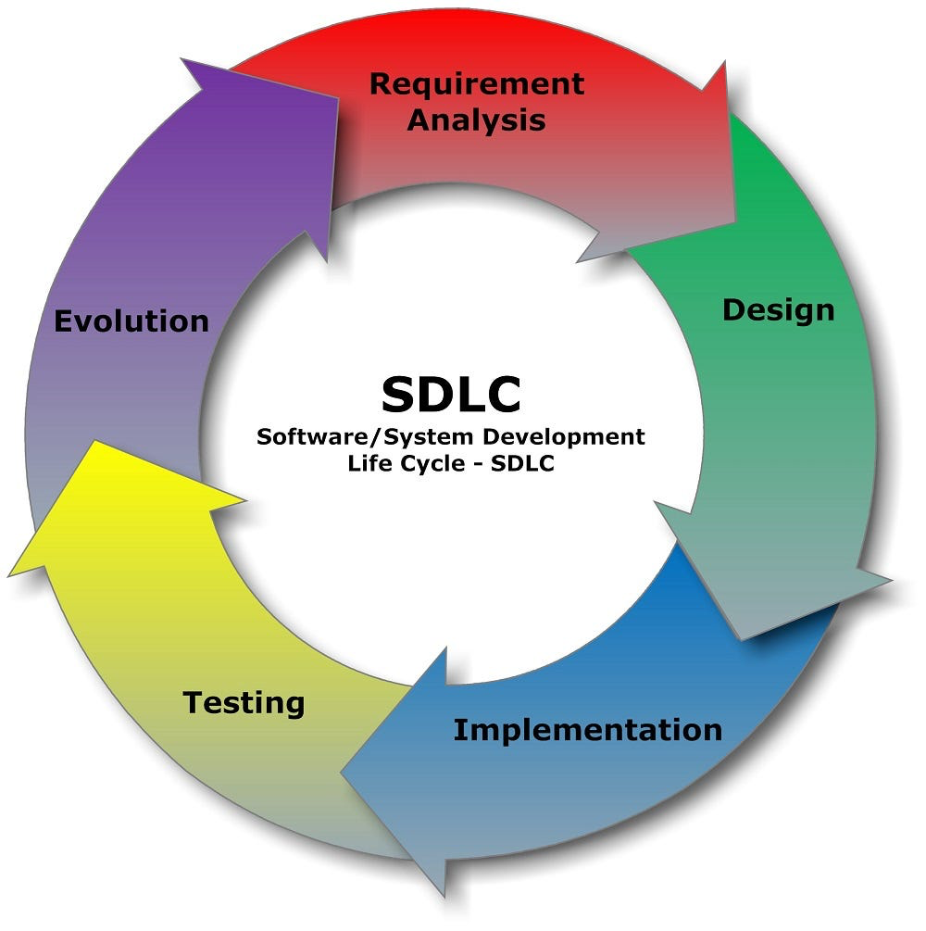
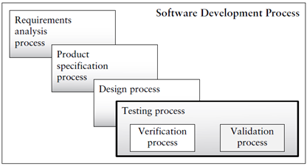
Testing as a Process

Slide 31

Testing as a Process
Two issues in software quality are:
Validation or user satisfaction
Verification or quality assurance.
Testing= Verification+Validation

Slide 32
Testing: Verification and Validation
Verification (Are the algorithms coded correctly):
Specific software development practices and process requirements have been fulfilled
“Are we building the product right?”
Verify that expected software development processes have been followed
Validation (Does it meet user requirements)
Software is meeting specified requirements for intended use
“Are we building the right product?”
Validate that the software is meeting its formal requirements

Slide 33
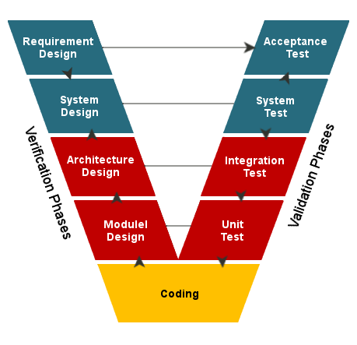
V-Model for Testing

Slide 34
Testing Strategy
We begin by “testing-in-the-small” and move toward “testing-in-the-large”
For conventional software
The module (component) is our initial focus
Integration of modules follows.
For OOP software
Our focus when “testing in the small” changes from an individual module (the coneventional view) to an OO class that encompasses attributes and operations and implies communication and collaboration.

Slide 35
Levels of Testing for Conventional Software
Unit testing
Concentrates on each component/function of the software as implementes in the source code
Integration testing
Focuses on the design and construction of the software architecture
Validation testing
Requirements are validated against the constructed software
System testing
The software and other system elements are tested as a whole.

Slide 36
Cont
Unit testing
Exercises specific paths in a component’s control structure to ensure complete coverage and maximum error detection
Componenets are then assembled and integrated
Integration testing
Focuses on inputs and outputs, and how well the components fit together and work together
Validation testing
Provides final assurance that the software meet all functional, behavioral, and performance requirements
System testing
Verifies that all system elements (software, hardware, people, databases) mesh properly and that overall system function and performance is achieved.

Slide 37
What Happens When Software Is Not Thoroughly Tested?
Undiscovered defects and incorrect/untested functionality can
lead to:
Software or web site crashes
Incorrect behavior
financial mistakes,
losing transactions or data,
incorrect calculations or actions (can lead to engineering or medical mistakes)
Reduced software performance
Slowness or
Inability to handle higher volumes of transactions or users

Slide 38
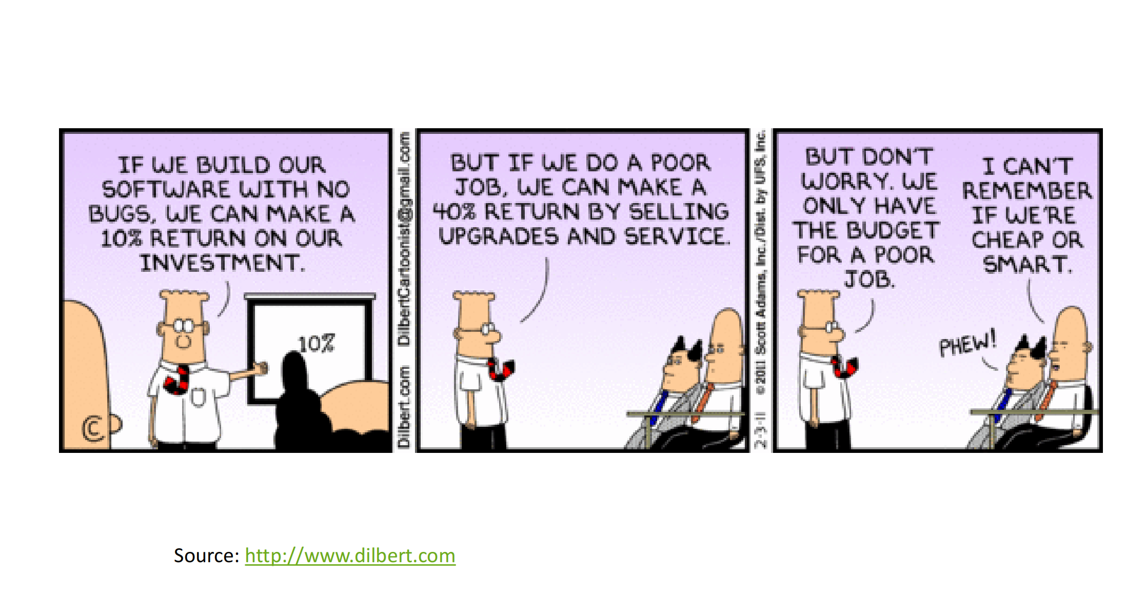

Slide 39
Balancing Testing Needs
While it is theoretically possible to find “all defects”, we are more likely to be able to find all/most defects in a simple program
The more complex a software system is, the harder it is to ensure that the system is mostly “bug-free”
Complexity of testing also increases when a system:
is not standalone, but may be interacting with other systems,
has a complex architecture and many components,
runs on a variety of devices, operating systems and platforms
Increased complexity of testing = higher costs and longer project delivery time
Systems that need to be close to “bug-free” will need a longer testing cycle and have higher testing costs

Slide 40
When Do We Feel Confident to Release a Product?
Testing process should give enough confidence that major paths and use cases through the system function as expected
We also look for successful testing of each of the system requirements
Ideally the test cases include a variety of data sets and user action combinations
We also want to try out various extreme situations – high volume of transaction, extreme data values, high user volume, security_x0002_related considerations, and any other situations that may be specific to a given project

Slide 41
Test-Driven Development Approach
Test-Driven development blends development and testing together
“Develop a little and test a little” approach
Instead of leaving testing to QA engineers, testing is the driving force of the entire development process
Quality and testing is considered to be a prevention activity, done during development
Traditionally QA is a detection activity, done after development completes

Slide 42
Testing Roles in Test-Driven Development: Software Engineer
Software Engineer (SWE)
Traditional development role, which in addition to design and development activities also writes test code for the modules SWE works on
Responsible for Test-Driven Design (TDD), unit tests, and creation of system tests for his/her modules
Responsible for overall quality for any code he/she worked on (created, modified, fixed)
How is this different from the traditional approach to division of work between development and QA engineers?

Slide 43
Testing Roles in Test-Driven Development: Software Engineer in Test
Software Engineer in Test (SET)
Developer with primary focus on testability and general test infrastructure
Responsible for design review from quality perspective, code quality and risk analysis.
Responsible for code refactoring to increase testability
Write unit testing frameworks and automation
Focus on increasing quality and test coverage
SWE and SET are partners in the codebase
How are these responsibilities accounted for in a traditional QA organization?

Slide 44
Testing Roles in Test-Driven Development: Test Engineer
Test Engineer (TE)
Focus on testing code from user perspective, including use cases and usage scenarios
Develop automation scripts and code that drives usage scenarios and mimics users
Lead testing work of SWEs and SETs
Organize quality practices
Responsible for test result interpretation
Drive test execution
Build end-to-end test automation
Also responsible for communication of risks in design and feature complexity
What are the similarities and differences between this role and QA engineering roles in a traditional QA organization?

Slide 45
Release Approach
In addition to test-driven development, some major company in area of IT also adopted iterative development release lifecycle
Products are released with a minimum core set of features
Quick subsequent iterations allow to get feedback from users and incorporate the feedback into each successive release
Quality is a key consideration for each release
Releases are frequent and add a small number of features in each
Products proceed through a number of “channels” prior to being released to users

Slide 46
Product Code Channels
Company like Google uses a concept of channels to move code through various stages of build/test/fix/release process
Canary Channel
Daily builds – used by engineers (dev and test) and managers working on the product
Dev Channel
Weekly builds – sustained some usage and testing
All engineers are required to pick up Dev channel builds and use them for work and testing
Test Channel
Best build of the month – passed most sustained testing and the one engineers trust most for work
Can be picked up by internal users and a candidate for Beta Channel
Beta or Release Channel
Stable test channel builds that passed internal usage and quality test standards; available for external use

Slide 47
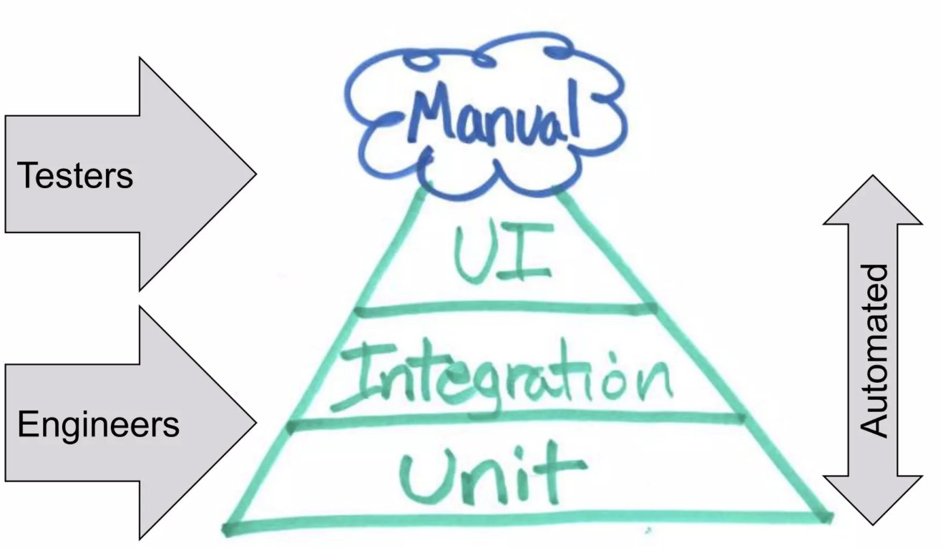
Types of Testing
1. Manual Testing
2. Automation Testing

Slide 48
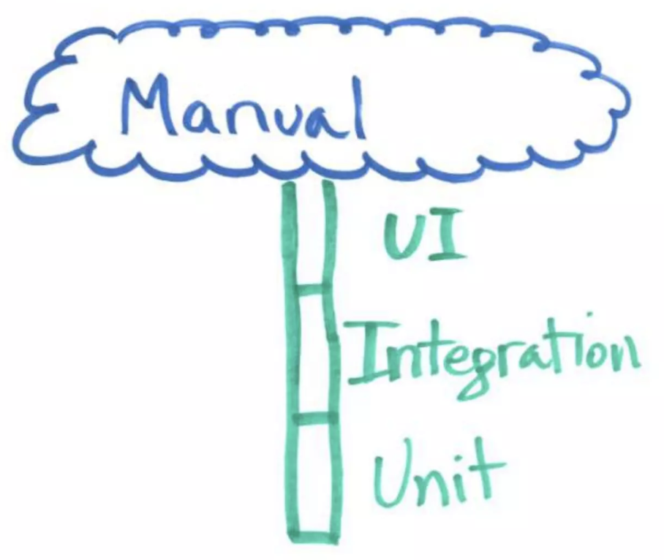
Manual Testing
Manual testing is done in person, by clicking through the application or interacting with the software and APIs with the appropriate tooling.
This is very expensive since it requires someone to setup an environment and execute the tests themselves, and it can be prone to human error as the tester might make typos or omit steps in the test script.

Slide 49
Automation Testing
are performed by a machine that executes a test script that was written in advance.
These tests can vary in complexity, from checking a single method in a class to making sure that performing a sequence of complex actions in the UI leads to the same results.
It's much more robust and reliable than manual tests – but the quality of your automated tests depends on how well your test scripts have been written.

Slide 50
End of Chapter 1

